Slide 2
3 Meetings to tackle a giant topic

Slide 4
Aim
Provide a “go-to” resource
Outline what the current (enforcement discretion state) enables
Practical outline of what’s needed
Discuss key issues related to telepathology and remote digital pathology
Other topics?
…
…
…

Slide 5
Scope
Pathology and Laboratory Medicine
Anatomic
Pathology
Cytopathology
Subspecialties
e.g., “breast”
Molecular
Diagnostics
remote result release
CMS Memorandum
“Sections”
Subspecialties
Clinical Pathology
Function
signing out cases remotely
reviewing cases remotely
using digital pathology
using digital pathology remotely
"key out results obtained at CLIA lab” <VPN example>
"taking slides home, reviewing using a microscope in home office” <home screening>
"using WSI in a CLIA laboratory” <primary review>
"having a WSI process in CLIA laboratory. Primary review at an off-site location” <primary remote review>

Slide 6
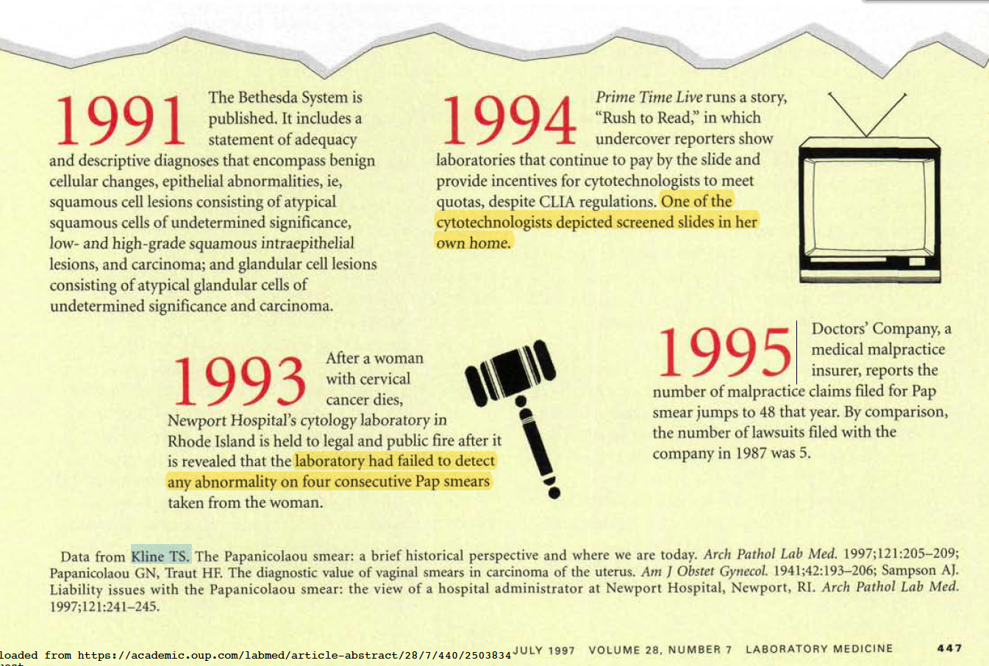

Slide 7
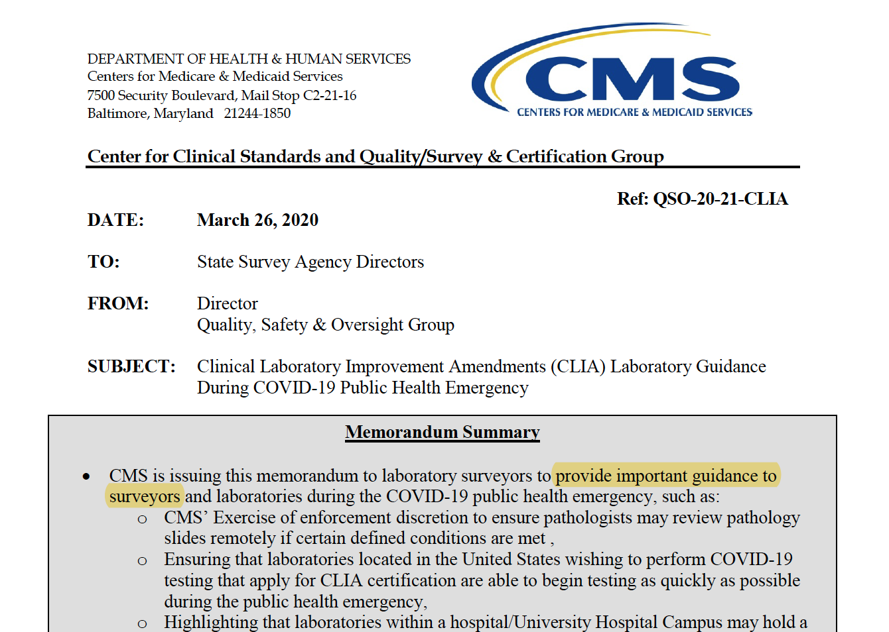
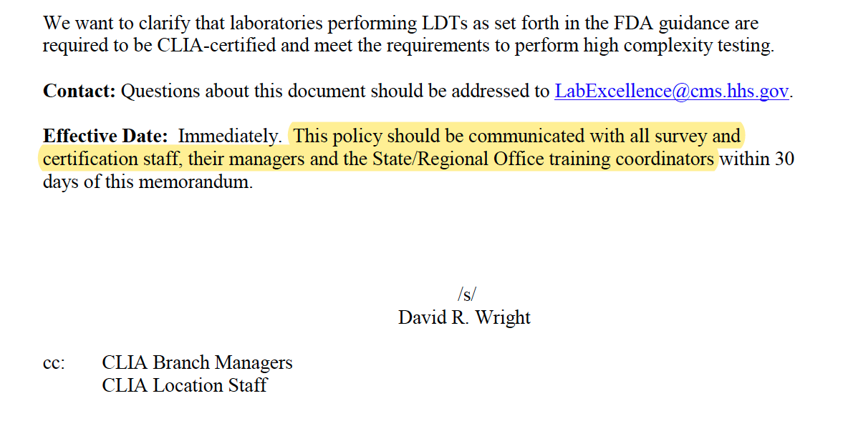
Target audience… and why

Slide 8
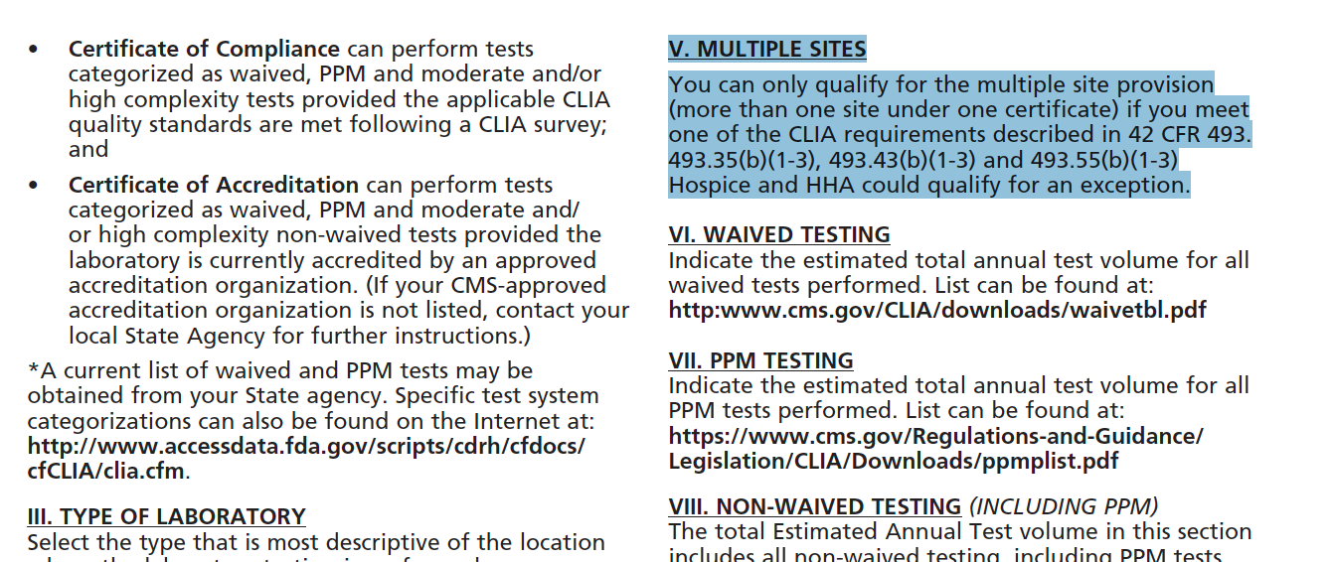
Eligibility

Slide 9
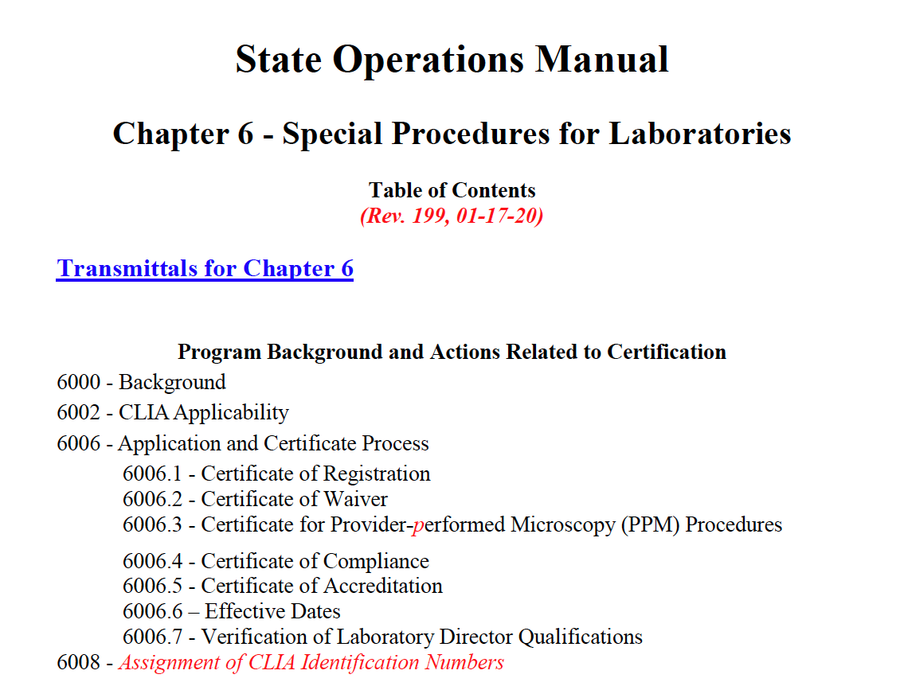
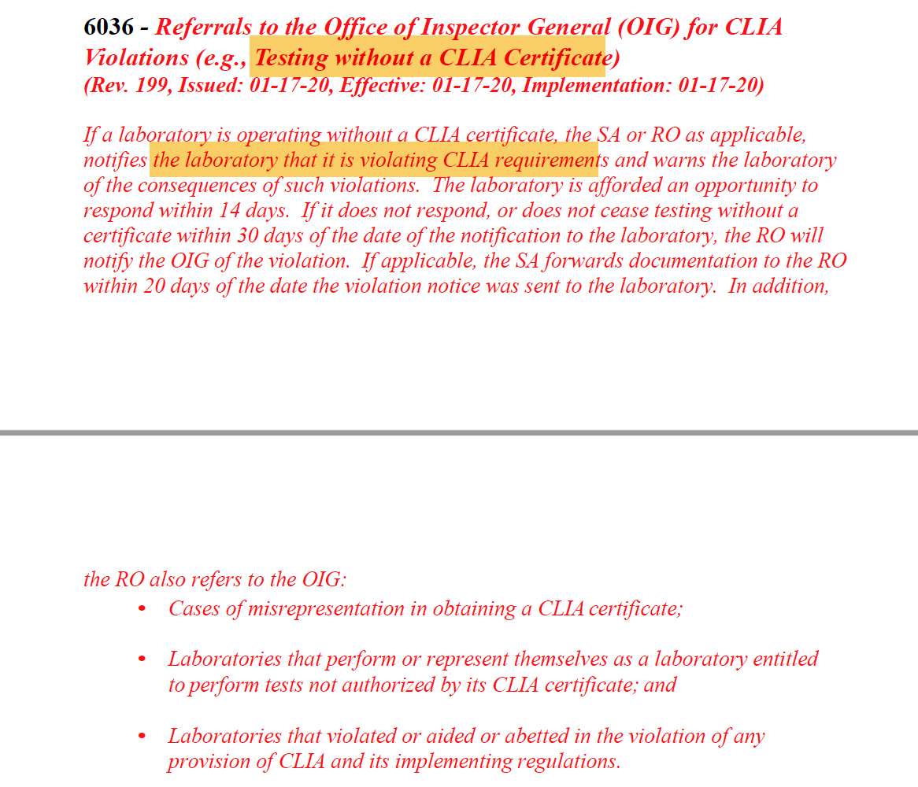
Target audience… and why

Slide 11
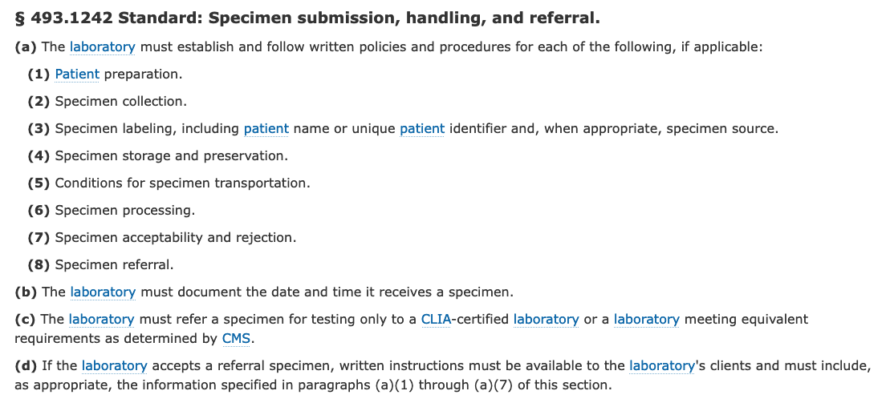
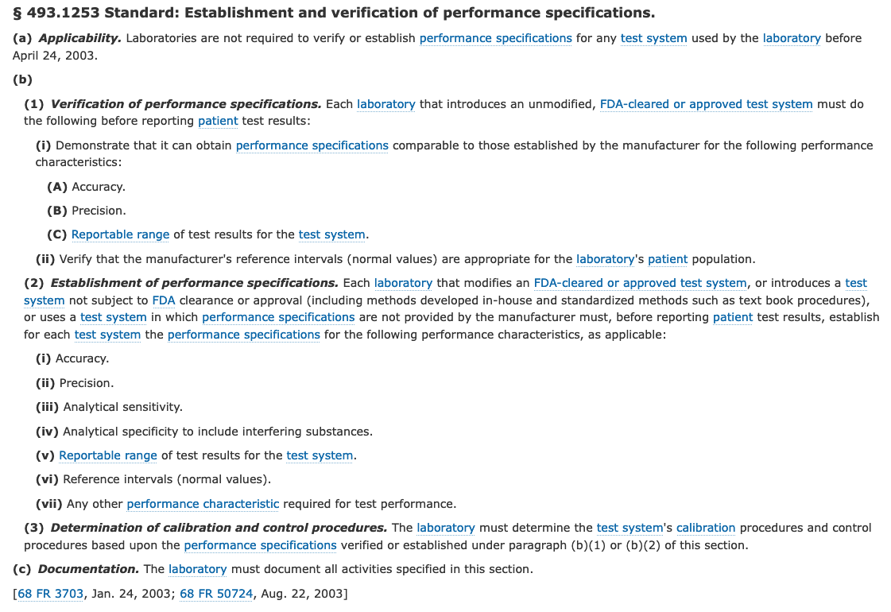
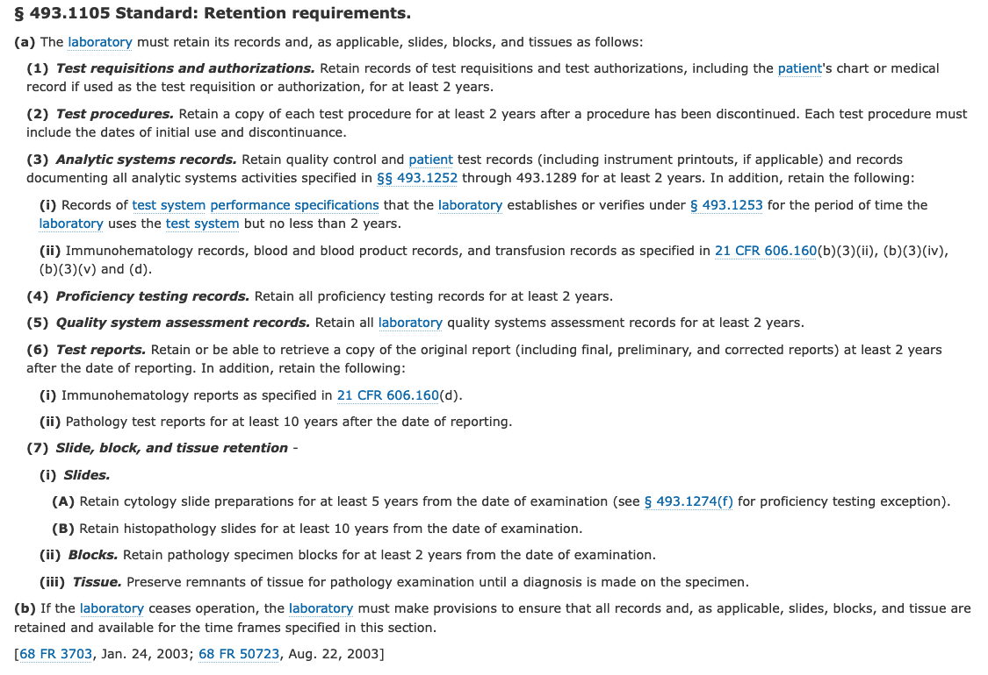

Slide 12
Discussion
Dr. Balis “Core regulatory lesion is restriction of professional practice”
”historic regulatory overreach”
Compare radiology (contrast, different regulatory stringency, professional activity)
Pathology => regulatory framework is prescriptive
Radiology => (HIPAA, technical ability).
Aim: Carving out ”the practice of pathology”
Key element is “professional judgement by pathologist”
Practice of pathology (“professional”) needs to be independent of the physical location
Professional judgement cannot be part of the regulatory confines.

Slide 13
Discussion
Dr. Sirintrapun: “who are the surveyors”
=> provide list
Dr. Evans:
Image quality => pathologist review is ultimately QA/QC check
Pathologist would not use “poor quality” sections/stains/scans
Re-iterates the point of “review” is professional activity.

Slide 14
Discussion
Dr. Sirintrapun
Accreditation => guidance already there
Credentialing (“institutional oversight”)
“Validation” <=. Inspection how do you use this…
xxx questions during audit
Can we define this in the context of today?
Professionalism vs. process in lab…

Slide 15
Discussion
Distinguish “physical media” (e.g. physical slide) vs. “digital”/”data review”
Approach to tackle regulatory framework from state operations manual “amendment” => specifying
Dr. Sirintrapun => account for various practices (e.g. molecular, digital pathology)
Dr. Balis => could also account for remote review of microbiology
CP should also be in scope.

Slide 16
Discussion
Dr. Goldstein: Does the medical legal risk around s/o “blurry image” need to be preserve the view
Tracking of metadata, quality tracking
Dr. Balis: can close gap in current practice
E.g., reviewed all fields, magnification, time…
Digital modalities may provide additional tracability/transparency “fiduciary transcripts”
Dr. Obstfeld: clinical pathology angle is important
Should technologist review (screening) be included in these considerations. At home verification…

Slide 17
Discussion
Dr. Torres: pathway => how to communicate is very important
Dr. Evans: risk of NOT doing it… we should not take “experts” out of the loop because they are remote
Rules / guidance should not be role-based but asset based

