Slide 1
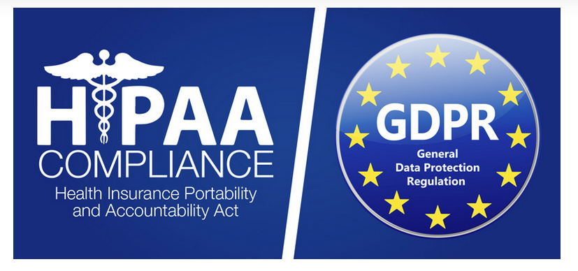
GDPR vs. HIPAA
Joe Lennerz MD PhD
Massachusetts General Hospital

Slide 2
How Does GDPR Compare to HIPAA?
GDPR and HIPAA are two distinct sets of regulations that have contributed to a greater sense of security and privacy, particularly in the realm of information and data protection

Slide 3
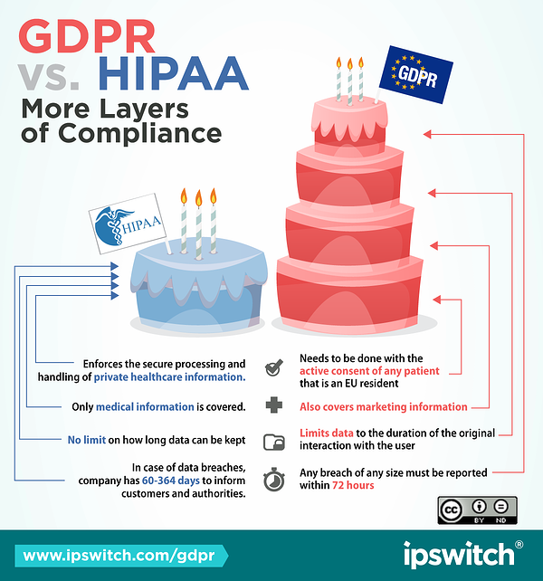

Slide 4
The General Data Protection Regulation (GDPR)
enacted by the European Parliament, the European Commission, as well as the Council of the European Union on April 27, 2016, and went into effect on May 25, 2018.
GDPR replaced a previously enacted data protection act and was
designed to consolidate data privacy laws across Europe
Aim: protect the data security of all EU citizens
Reimagine the way companies and industries across Europe approach data collection and security.
GDPR is considered to be one of the most significant changes in data privacy regulation in twenty years.

Slide 5
GDPR is composed of 91 articles 7 key points
Individual consent is required before any data can be collected or processed.
Individuals will be notified promptly if their data is breached or interfered with.
All data will be made and remain anonymous.
International data transfers will be managed more securely.
Companies are required to appoint a data protection officer (DPO) to protect client data.
Any company that provides a service or product to residents of the EU is required to comply with the GDPR.
Companies that do not comply with the GDPR regulations will be subject to hefty fines.

Slide 6
Health Insurance Portability and Accountability Act (HIPAA)
HIPAA is an American law that was enacted in 1996.
Designed to protect sensitive medical information that is electronically transferred and received.
Initially created to help patients retain proper insurance in the case of job loss or change.
HIPAA decreases medical cost by allowing healthcare administrators to use electronic documentation and records, which are more secure and more efficient than paper documentation.
HIPAA was regulated and continues to be enforced by the United States Department of Health and Human Services.

Slide 7
HIPAA and HITECH and ARRA
The Health Information Technology for Economic and Clinical Health Act (HITECH) is a subset of the American Recovery and Reinvestment Act (ARRA) of 2009
HITECH act broadened the scope of what HIPAA
expanded the privacy and security protections offered under the act by increasing legal actions available for non-compliance
Systems affected by HIPAA laws are required to notify patients of any data breach and are subject to substantial fines and penalties for violations

Slide 8
Privacy requirements under HIPAA
Patient identity and social security number
Patient diagnosis and condition
Record of care or treatment provided to a patient
Payment information that could potentially be used to identify the patient

Slide 11
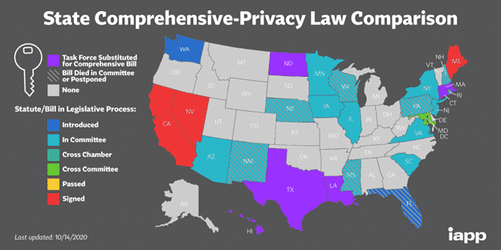
What’s happening now in the US?

Slide 12
Expectations for 2022
State-specific privacy Laws: more states will follow California’s footsteps to pass privacy laws, with provisions that are similar to the CCPA, but with local implementations.
Voluntary Compliance with Privacy Laws: businesses will likely opt for a more voluntary compliance framework. Large multinational companies will likely try to impose their Will and influence on lawmakers who review and assess privacy-related bills. Eventually, businesses will retrofit compliance requirements to gain competitive advantage.
Constitutional Challenges: While some states may pass privacy laws, opponents will argue that these laws impose unnecessary burdens on interstate commerce and constitutional rights. Thus, the road to passing these laws will be filled with challenges requiring dynamic negotiations.

Slide 13
Expectations
A Federal Privacy Law: with a potentially-new political majority in Washington, Congress may incorporate principles of CCPA into drafting a federal privacy law in order to birth national uniformity as it relates to data privacy.
Increased Security Expenditure: Businesses will start investing more in upgrading their security infrastructure, technology, encryption, and training since the California Consumer Privacy Act offers statutory damages in a data breach.
Increased Automation: Since consumers will take center-stage when the privacy laws are enforced, organizations will switch to digital ways of responding to consumer complaints and requests since the manual processes are more prone to error. Thus, more automated and scalable response programs to handle clients will come into the picture.

Slide 14
Additional approaches

Slide 15
Compliance certifications
SSAE 16 SOC 2 TYPE 2
HIPAA COMPLIANCE
PCI COMPLIANCE

Slide 16
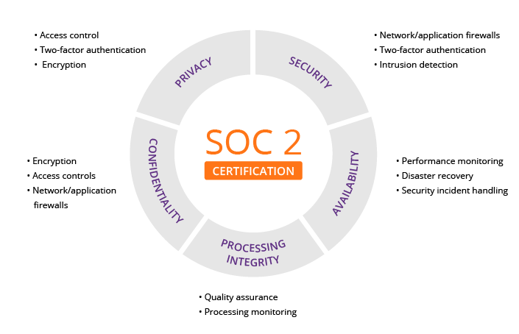

Slide 17
Thanks a lot
Jochen K. Lennerz, M.D., Ph.D. Medical Director, Center for Integrated Diagnostics Associate Chief, Department of Pathology Massachusetts General Hospital Associate Professor, Harvard Medical School 55 Fruit Street, Boston, MA, USA 02114-2696 Phone: 617-643-0619 Fax: 617-643-1623 Email: JLennerz@partners.org

