Slide 1
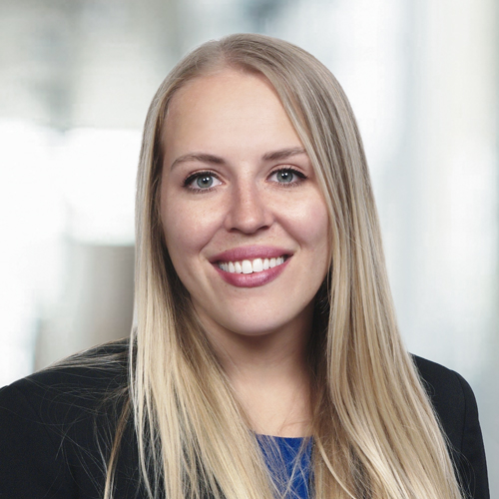
Aubrey Walker PIcc Project Manager
B.S. in Hospitality and Business Management
Previous experience from the Hospitality and Tourism Industry, I changed career paths during the COVID-19 Pandemic
You can reach me at digipathalliance@gmail.com
Fun Fact: I love to travel; I have been to 43 of the 50 States! (And 7 Countries!)
Looking forward to positively contributing to the Alliance as it works towards its aim of coming together to transform the field of digital pathology.

