Slide 1
QSO–22–13–CLIA outlines enforcement discretion in certain clinical laboratory practices.
Joe Lennerz MD PhD
Center for Integrated Diagnostics
Boston, MA, USA

Slide 2
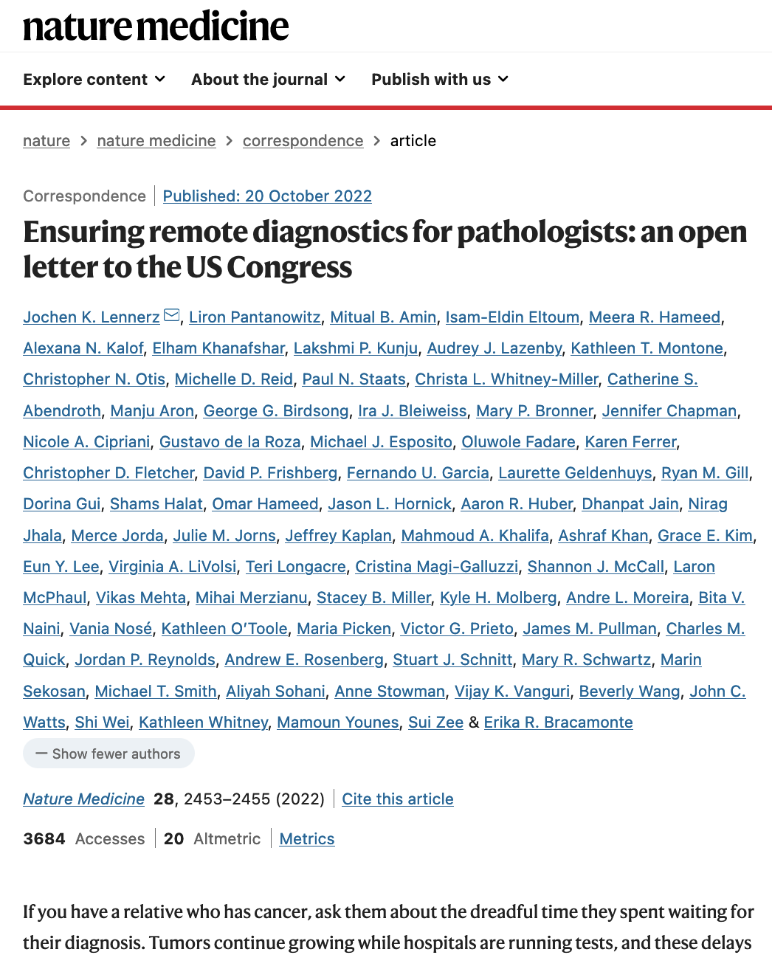
Background
Enforcement discretion allowed remote examination of clinical cytogenetics digital images during the COVID-19 pandemic under specific conditions.
Some parties desire permanent enforcement discretion for remote examination of cytogenetics images.
Notes:
https://www.nature.com/articles/s41591-022-02040-6

Slide 3
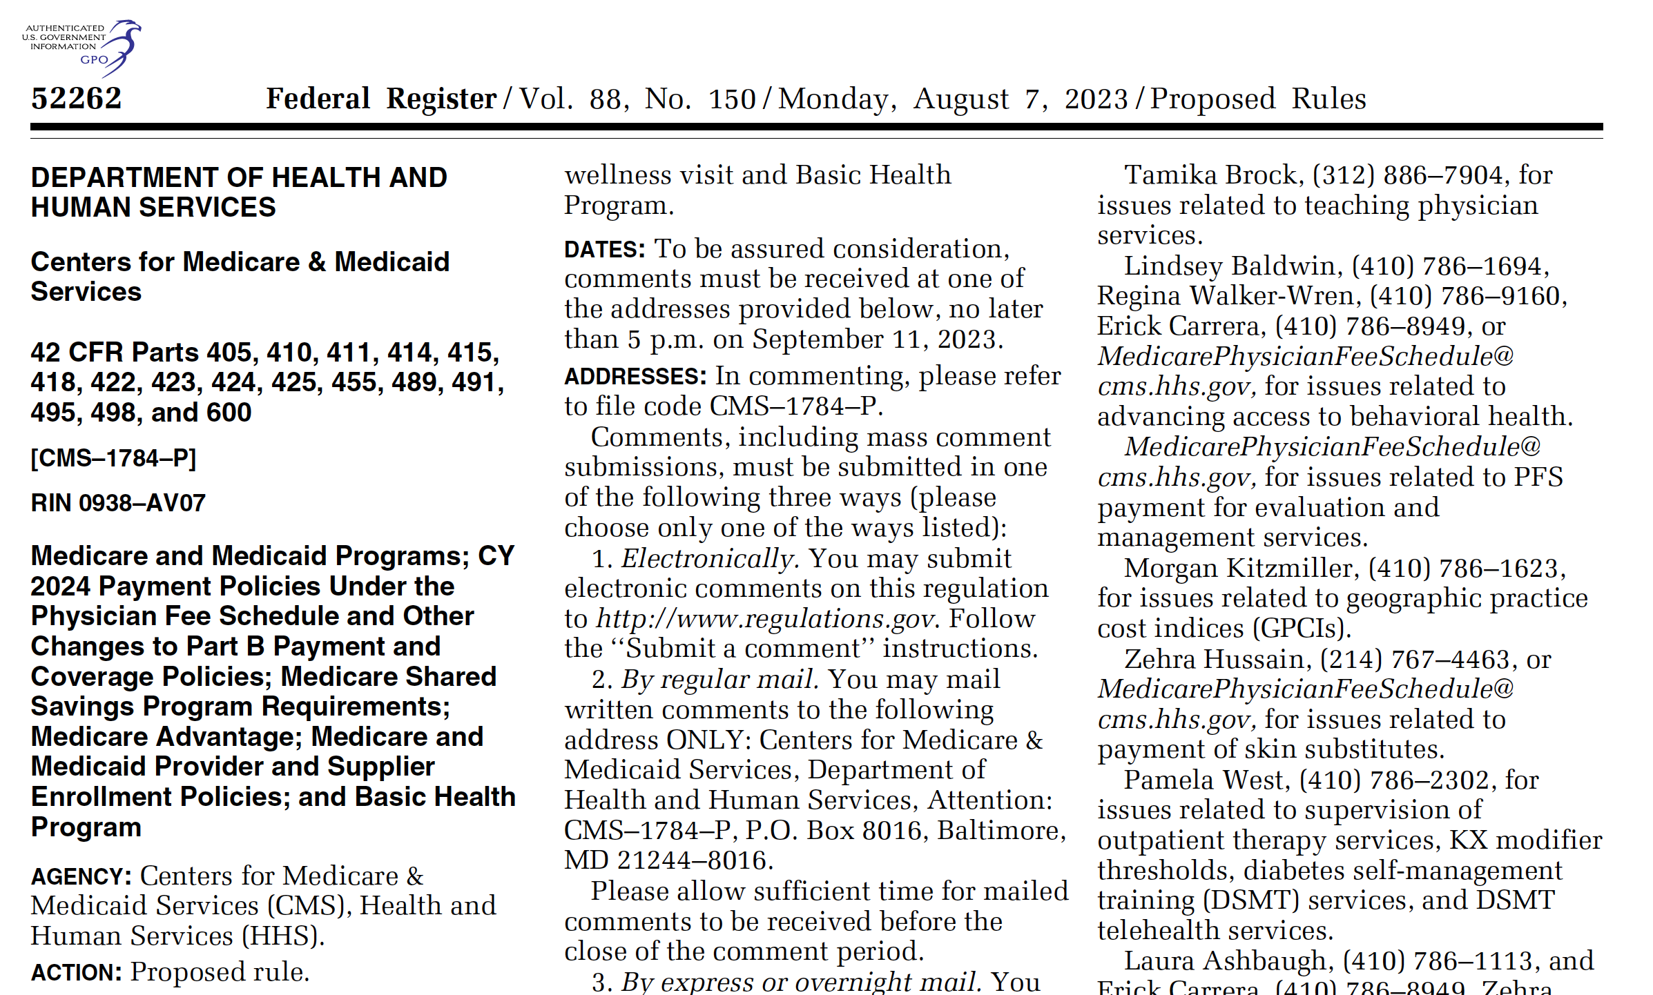
Overview
Medicare and Medicaid
Programs; CY2024 Payment
Policies, etc… 936 Pages
So-called “Proposed Rule”
Highly complex
Section P.
Request for Information: Histopathology, Cytology, and Clinical Cytogenetics Regulations Under the Clinical Laboratory Improvement Amendments (CLIA) of 1988

Slide 4
Solicitation of Public Comments:
CMS (Centers for Medicare & Medicaid Services) is seeking public input on CLIA oversight areas: Histopathology, Cytology, and Clinical cytogenetics.
Questions posed include defining remote testing locations, conditions for pathologists to examine slides/images remotely, and ensuring quality testing at remote sites.
Pathologists that currently hold a CLIA certificate are exempt from this enforcement discretion

Slide 5
Remote Examination of Slides/Images by Pathologists:
The memo allows pathologists to remotely examine histopathology and cytology slides/images, with specific conditions:
The primary laboratory must have a CLIA certificate for pathology with histopathology and cytology subspecialties.
The remote location should comply with relevant laws, like HIPAA.
Written procedure manuals for tests must be available at the remote location.
Specimen retention times must be adhered to.
Retention time for histopathology slides (10 years), specimen blocks (2 years), preserved tissue remnants (until a diagnosis was made), and cytology slides (5 years).
Equipment and supplies cannot be permanently stored at the remote site.

Slide 6
Clinical Cytogenetics:
CLIA certification is required for laboratories performing clinical testing.
A laboratory can outsource testing but must refer to CLIA-certified facilities.
Clinical cytogenetics testing is categorized as high complexity.
A testing workflow model may involve different facilities for bench and non-bench activities.

Slide 7
Input…
Histopathology: Public input sought on oversight of tissue sample preparation, criteria for personnel performing automated IHC staining, acceptable timeframes for reviews, and qualifications for supervisors.
Histopathology and Cytology Testing at Remote Locations: Input requested on defining remote testing locations, revising CLIA regulations, conditions for remote examination of slides/images by pathologists, and surveying remote locations.
Clinical Cytogenetics: Comments requested on circumstances allowing remote examination of cytogenetics images, quality assurance for remote testing, and primary laboratory responsibilities for remote sites.

Slide 8
General concerns regarding remote work
Data Integrity and Accuracy: Ensuring that remote site documentation accurately reflects the findings and results of examinations is crucial. Remote pathologists or cytogenetics experts must accurately record their observations and interpretations to maintain the quality of diagnostic information.
Patient Privacy and Data Security: Remote examination involves sharing patient data and medical information across different locations. Maintaining patient privacy and adhering to data security regulations (such as HIPAA) are essential to prevent unauthorized access, breaches, or mishandling of sensitive patient information.
Compliance with Regulations: Remote sites need to adhere to the same regulatory standards as the primary laboratory. This includes complying with CLIA requirements, HIPAA regulations, and any other applicable federal laws. Documentation practices should align with these regulations to avoid legal and regulatory issues.
Timely Reporting and Communication: Effective communication between the remote site and the primary laboratory is crucial. Prompt reporting of results, interpretations, and any concerns is necessary to ensure that patient care is not compromised due to delays in information sharing.
Maintaining Procedure Manuals and Protocols: Remote sites must have access to and follow the same procedure manuals, protocols, and guidelines as the primary laboratory. Proper documentation of procedures and protocols is necessary to ensure consistent and accurate practices across all locations.
Quality Control and Assurance: Remote sites need to establish robust quality control and quality assurance measures. Adequate documentation of these measures, along with regular audits and reviews, helps ensure that the remote site's practices meet the required standards.
Training and Competency: Remote personnel must undergo proper training and demonstrate competency in their roles. Documenting training records, certifications, and ongoing professional development is essential to ensure that qualified individuals are performing examinations.
Tracking and Traceability: Documenting each step of the examination process, from specimen collection to reporting, is important for tracking and traceability. This documentation helps identify any issues that might arise and ensures a clear record of the entire testing process.
Transition and Continuity: In situations where remote site personnel change or when testing responsibilities transition back to the primary laboratory, proper documentation ensures a smooth transition and maintains the integrity of patient records.
Audit Preparedness: Remote sites should be prepared for audits or inspections by regulatory agencies or accreditation organizations. Proper documentation can facilitate these audits by demonstrating compliance with regulations and quality standards.

Slide 9
Recommendations – Potential comments
Clear Guidelines for Billing Location and Operations: The memorandum should include explicit guidelines regarding how billing for remote examination services should be handled. It should outline whether the billing should be attributed to the primary laboratory or the remote location. Clarification on the necessary documentation to support billing, such as proper coding and diagnostic reports, would ensure consistent and accurate billing practices across all sites. Additionally, addressing potential scenarios where multiple locations are involved in testing, and how cost-sharing or billing distribution should be managed, would provide transparency and guidance in this important aspect of remote examination.
Telehealth Infrastructure and Technology Standards: In order to facilitate effective remote examination, a recommendation should be included about establishing a standardized telehealth infrastructure and technology requirements. This would cover aspects like secure image transmission, high-resolution imaging capabilities, and real-time communication tools. Providing technical specifications, security protocols, and compatibility standards for equipment and software used in remote examination would ensure that examinations are conducted seamlessly while safeguarding patient data and maintaining diagnostic quality.
Risk Management and Contingency Planning: The memorandum should emphasize the importance of risk management and contingency planning for remote examination. This recommendation would include guidance on identifying potential risks, such as technical failures, communication disruptions, or data breaches, and developing strategies to mitigate them. Formulating clear contingency plans that outline steps to take in case of unexpected issues ensures that patient care and data security remain uncompromised even in challenging situations.

Slide 10
APPENDIX

Slide 11
Specific questions – Histopathology
Whether, and how, CLIA should provide oversight of histopathology preparation and processing of tissue samples for slide staining, specifically related to guidance for routine histopathology slide staining and complex IHC staining?
What criteria (for example, training programs, on-the-job training, experience, or academic degree) would interested parties recommend for personnel performing high complexity automated IHC staining?
How does the categorization of automated staining systems impact personnel who are currently performing this task but do not meet the qualifications for performing high complexity testing?
What is an acceptable timeframe between the review of the macroscopic gross tissue examination, and the review and confirmation of these tissue findings by a pathologist prior to the microscopic review of slides to protect the integrity of the macroscopic tissue?
What education and experience or training requirements should be required for individuals to qualify as a general supervisor (GS) for histopathology? If qualified, what is an acceptable timeframe for the GS to review and evaluate gross examinations under the specialty of histopathology?
What education and professional experience, or training requirements should be required for individuals performing gross tissue examination that have an associate degree from a histotechnician program or a PA who has training from an accredited program and is certified as a PA?

Slide 12
Specific questions – Histopathology and Cytology Testing at Remote Locations
How should ‘‘remote testing location’’ be defined?
How should the CLIA regulations be revised to allow pathologists to examine histopathology and cytology slides/images at a remote testing location?
What conditions (including, location(s)) should apply for a pathologist to examine histopathology or cytology slides/images remotely without obtaining a separate CLIA certification?
Under what conditions should a primary location cease permitting testing at the remote location?
How should the remote location be included on the final patient report?
How should CMS, SAs, or Accreditation Organizations perform onsite surveys at remote locations?

Slide 13
Specific questions – Clinical Cytogenetics
Under what circumstances should CLIA allow remote locations or testing facilities to examine clinical cytogenetics images without obtaining a separate CLIA certification?
Under what circumstances would the examination of clinical cytogenetics images be unacceptable for the remote location scenario?
What clinical cytogenetics testing processes should the primary laboratory have in place to ensure the remote site complies with the CLIA requirements?
What ‘‘conditions’’ or ‘‘criteria’’ would be necessary for the remote location to ensure quality testing for the examination of clinical cytogenetics images?

