Slide 1
OVarian cancer Subtype Classification and OUtlier DeTection (OV-SCOUT)
Ali Bashashati, Maryam Asadi, Hossein Farahani
Department of Pathology & Laboratory Medicine and School of Biomedical Engineering, University of British Columbia, Canada
PIcc OV-SCOUT Meeting I
May 31, 2022

Slide 2
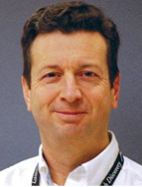
Ovarian Cancer
Deadliest cancer of the female reproductive system
Clinical diagnosis is based on microscopic examination of H&E images
Different etiologies, molecular profiles, clinical outcome
Treatment pathways are beginning to become more histotype-specific
Interobserver agreement in histotype classification is low/moderate
General anatomic pathologist: Cohen’s kappa coefficient 0.54-0.67, trained gynaepathologists: 0.89
Dr. Blake Gilks

Slide 3
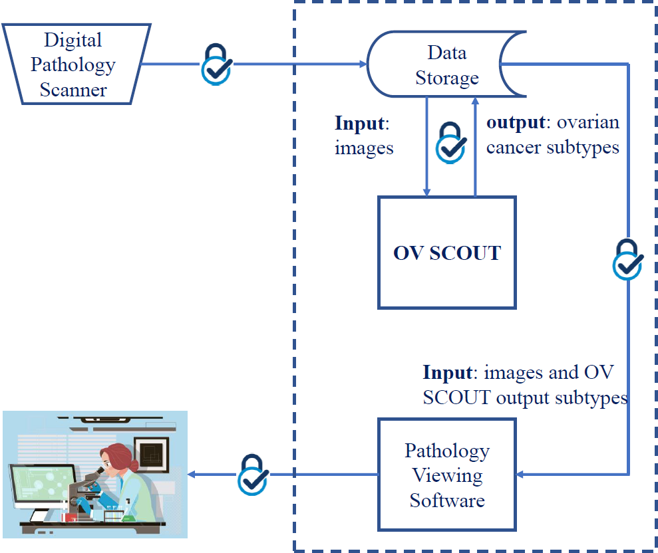
OV-SCOUT
An in vitro diagnostic medical device software
A deep learning-based package
OV-SCOUT outputs the following information to aid a pathologist to make the final diagnosis:
Either it identifies the slide as an outlier or as one of the five major histotypes of ovarian cancer
It also highlights areas containing the specific histotypes

Slide 4
Proposed AI Competition Tasks
Task 1: Diagnosis of the five major epithelial ovarian cancer histotypes
Task 2: Identification of outliers (i.e., cases that are suspected to have ovarian cancer but do not fall within the five histotypes covered in Task 1)
Such cases could include benign fallopian tube, mets to ovary, sertoli-leydig tumors, sex cord tumors, etc.

Slide 5
AI Competition Design (Task 1)
Development Phase |  | Validation Phase (Blinded to developers)
Training Dataset | Tuning Dataset | Test Dataset
450 patients Source: Vancouver (350) and external site A (100) | 125 patients Source: Vancouver and external site B | Set 1: Same as tuning set but scanned with a different scanner
 |  | Set 2: 500 patients Source: external sites C, D, E (whole sections and TMAs) * Include multiple slides from a patient
 |  | Set 3: 60 patients (stability analysis) Source: internal site Design: Scanning slides with different scanners at multiple different times
* Power analysis will be performed to make sure the tuning and test datasets have enough samples to assess the utility of AI models.

Slide 6
AI Competition Design (Task 2)
Development Phase |  | Validation Phase (Blinded to developers)
Training Dataset | Tuning Dataset | Test Dataset
450 patients Source: Vancouver (350) and external site A (100) | 125 patients + 25 outliers Source: Vancouver and external site B | Set 1: Same as tuning set but scanned with a different scanner
 |  | Set 2: 500 patients + 50 outliers Source: external sites C, D, E (whole sections and TMAs) * Include multiple slides from a patient
 |  | Set 3: 60 patients (stability analysis) Source: internal site Design: Scanning slides with different scanners at multiple different times
* Power analysis will be performed to make sure the tuning and test datasets have enough samples to assess the utility of AI models.

Slide 7
Clinical Validation
100 patients
Source: internal and external sites
Purpose: comparison between AI-assisted versus unassisted diagnosis
Design: unassisted followed by AI-assisted diagnosis by multiple pathologists (specialized and general)
Note: number of pathologists to be determined by power analysis

Slide 8
Discussion

