Slide 1
Data Review I Meeting
PATHOLOGY INNOVATION COLLABORATIVE COMMUNITY
May 24, 2022

Slide 2
Key Question: To what degree do pathologists depend on light microscopy for cancer diagnosis?
No clear answer offered by current literature
Relevant in the wake of rapid development of digital pathology, AI, cell-free DNA and liquid biopsy
Primary endpoint: Percentage of cancer diagnoses rendered by light microscopy for national extrapolation
Secondary endpoints: To find the percentage of microscopically diagnosed cancers
By ICD-O code
By primary site
By state of patient residence
Notes:
Small recap of what the goal of the project is

Slide 3
SEER Data Overview
Initial presentation
Cancer diagnostics
Local
Registry
State
Registry
Remove
Duplicates,
consolidate
SEER Dataset
Notes:
Reminder of seer database and how we came by our data

Slide 4
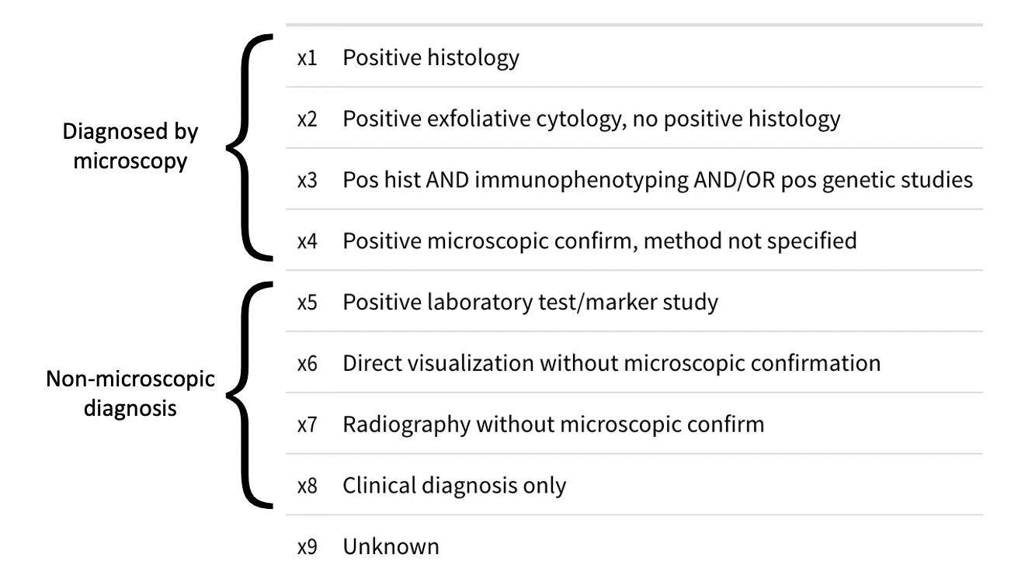
Diagnostic Confirmation

Slide 5
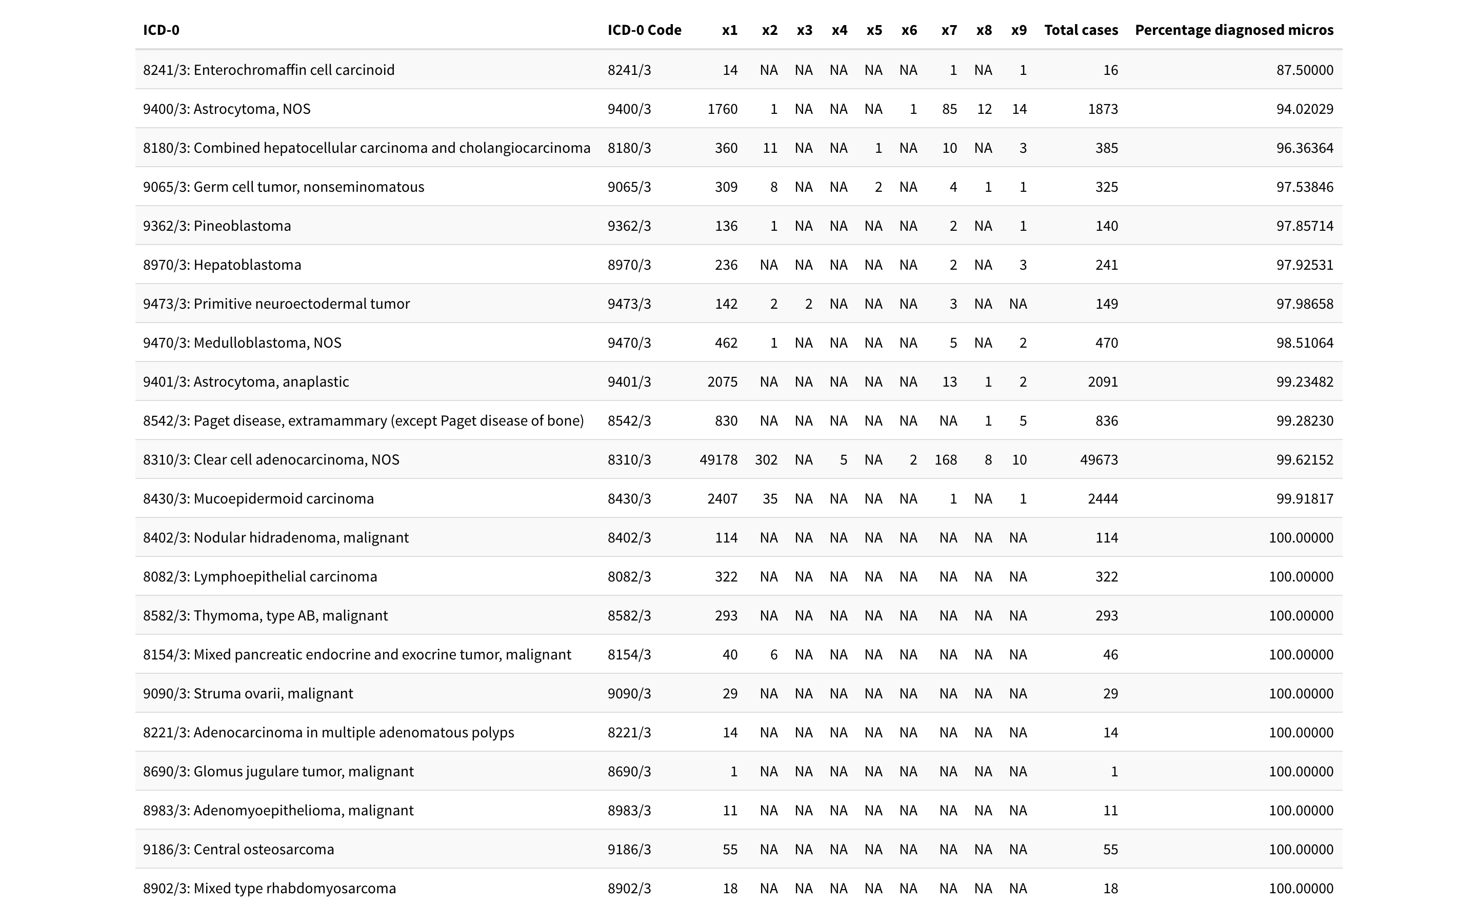
Solid Tumors: 8000/3 – 9589/3
Notes:
Demonstration of what our data looks like when grouped by ICD-0 ,, highlight x3 as not a diagnostic category for solid

Slide 6
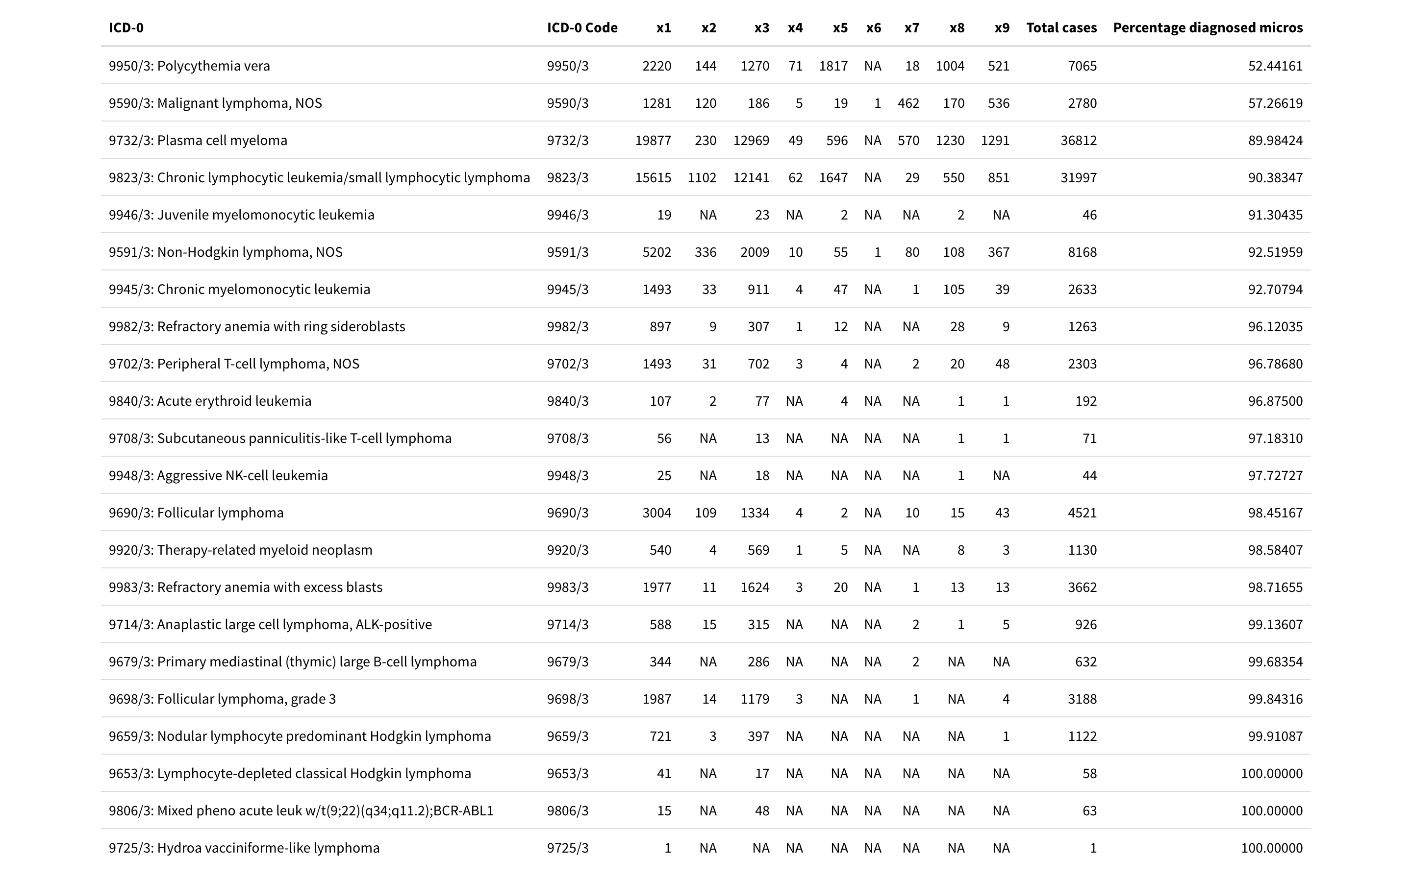
Heme Tumors: 9590/3 – 9971/3
Notes:
Same demonstration for heme, x3 is a viable diagnostic category

Slide 7
What’s new in SEER 2.0
Inclusion of cell free DNA advancements
Consider including numbers (commercial partners?)
Inclusion of digital pathology
Could we add numbers ?
Inclusion of SEER database update?
Other “new trends”

