Slide 1
Discussion and Wrap-Up
PATHOLOGY INNOVATION COLLABORATIVE COMMUNITY
June 10, 2022

Slide 2
Agenda
Database Comparison Update
Time Trends
“Selected Tumors Settings”
Results

Slide 3
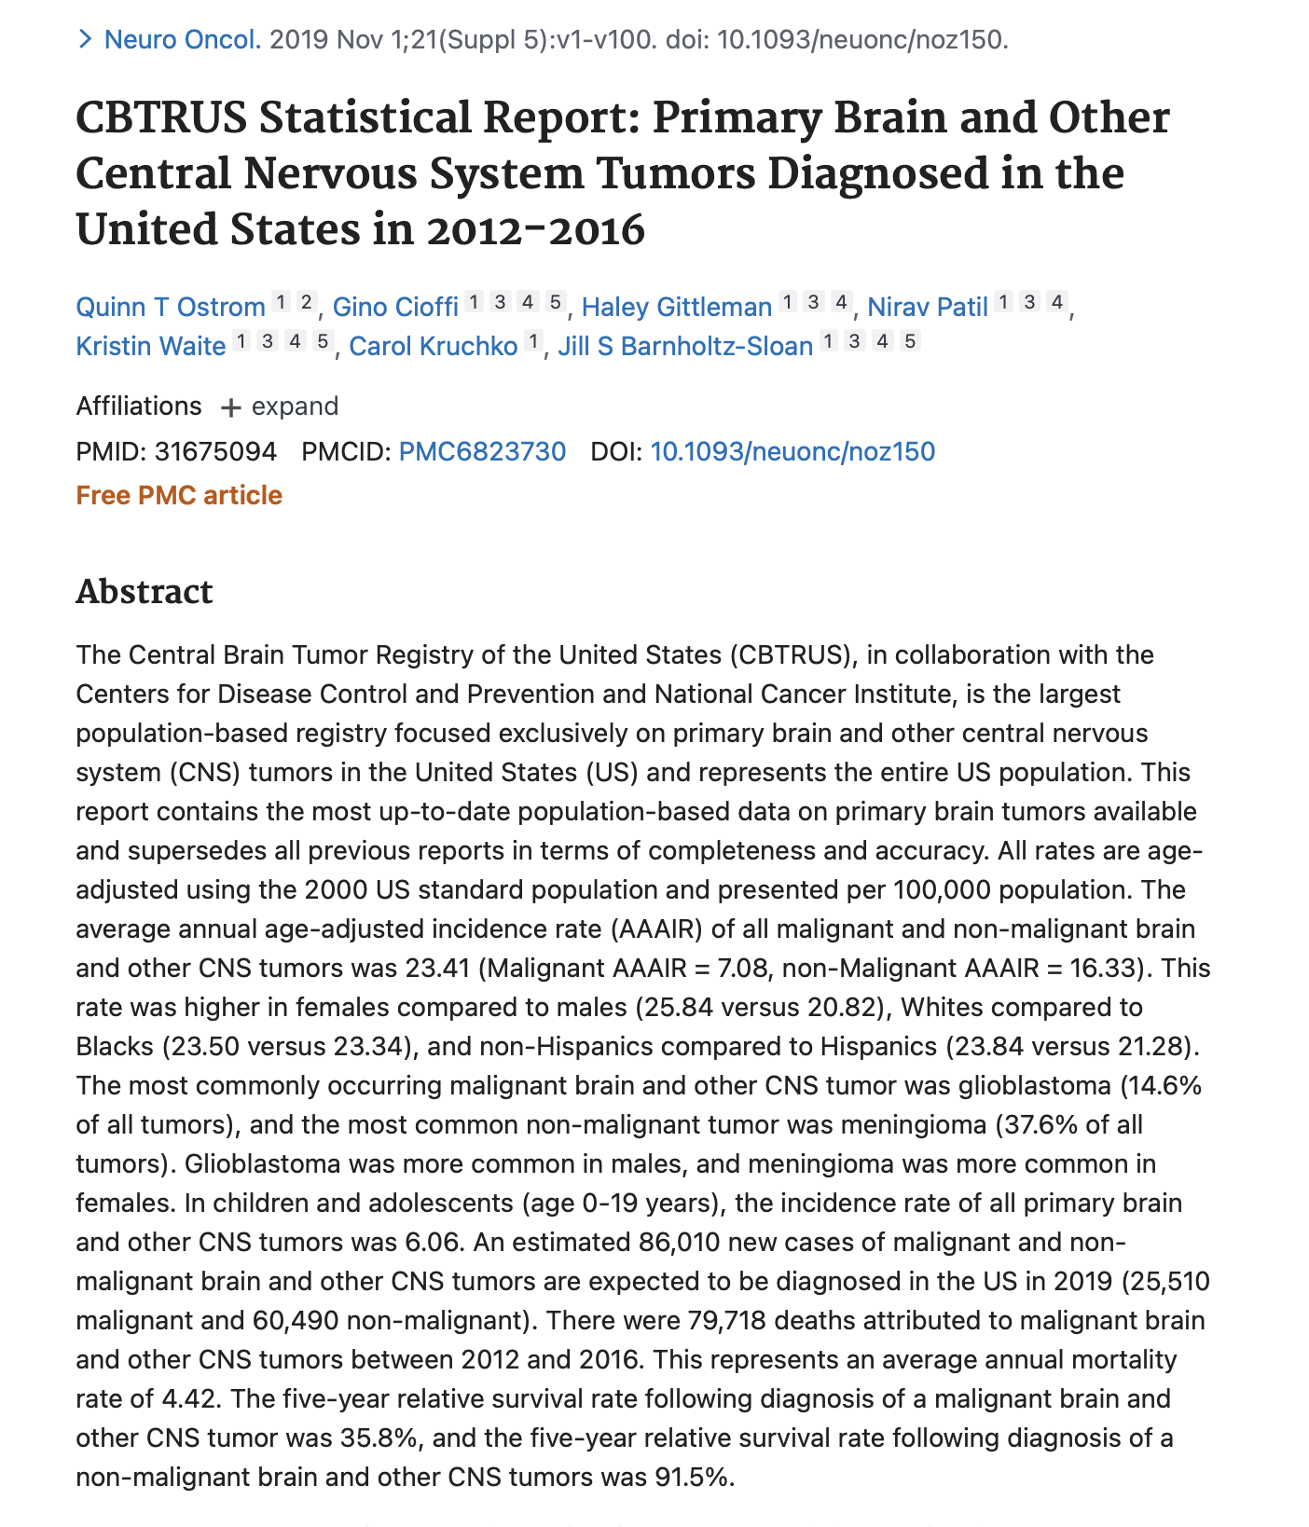
NAACCR data

Slide 4
NAACR access still pending

Slide 5
Time Trends
Solid
Heme

Slide 6
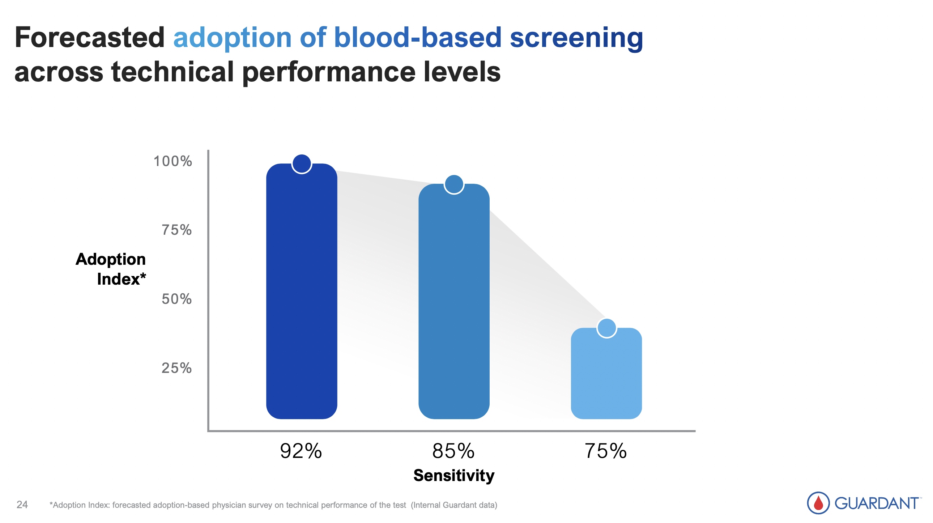
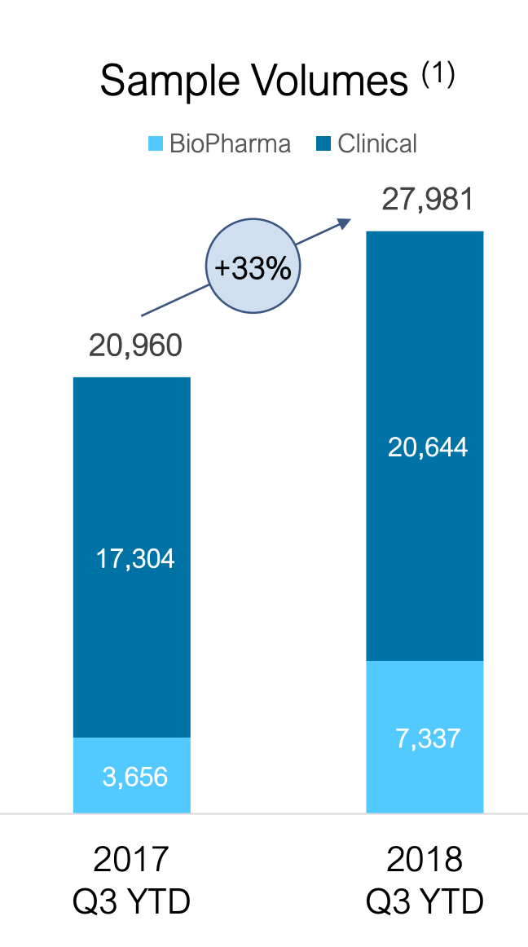
Guardant data – cell free data
* Jan 10, 2022 JP Morgan presentation
* Jan 10, 2022 JP Morgan presentation

Slide 7
“Tumor settings” -- joe
Solid tumor
Prostate cancer (bone, PSA)
NSCLC (“genotypes”)
Breast cancer
Retinoblastoma (“miscoding”)
Malignant placental trophoblastic tumor
Glioma malignant
IDH-mutant
IDH-wild type
Hematologic malignancies
B cell leukemia
CLL
Primary effusion lymphoma
Myeloid neoplasm with PDGFRA rearrangement
Waldenstrom macroglobulinemia
Notes:
Does not include “site” (pontine, optic nerve) =>

Slide 8
Results
Heatmap
Tumors of interest
Time trends
Novel technologies

