Slide 1
Findings and Results
PATHOLOGY INNOVATION COLLABORATIVE COMMUNITY
June 03, 2022

Slide 2
Agenda
Primary Endpoint
Database Comparison
Non-microscopic Cases
Summary

Slide 3
Notes:
Manuscript table 1,, shows diag conf code breakdown

Slide 4
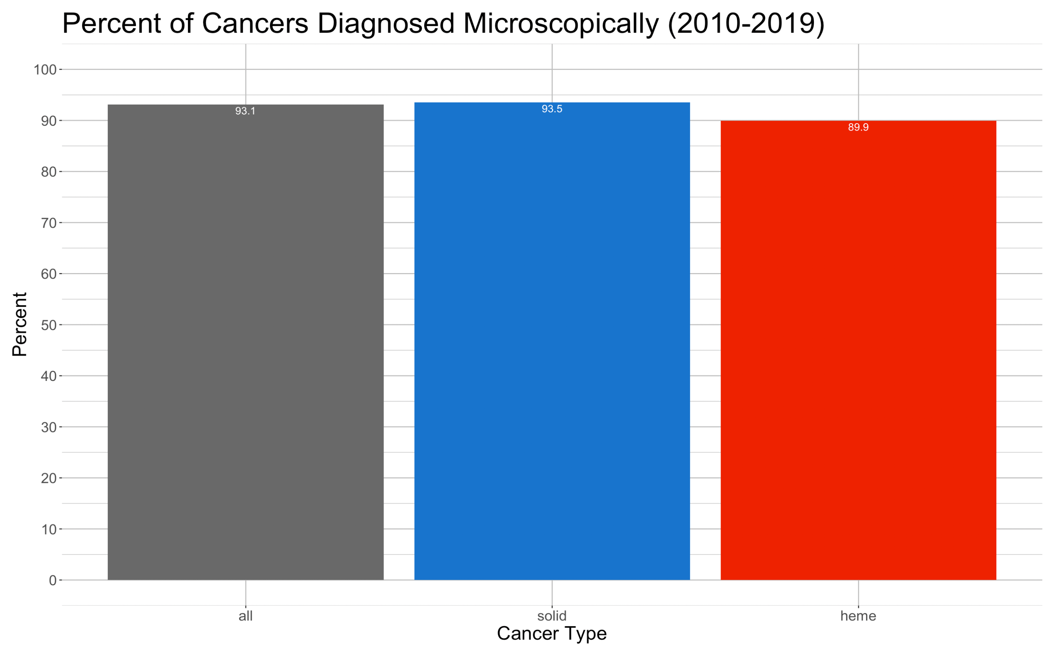
Primary Endpoint
Percentage of cancer diagnoses rendered by light microscopy
93% of all cancers diagnosed through microscopic means
7,043,154
of 7,564,158
6,274,902
of 6,709,748
768,252
of 854,410
Notes:
Of note, many more solid cases than heme cases so not weighted equally

Slide 5
Database Comparisons
Diagnostic Confirmation |  | NPCR + SEER Nov 2017 Sub | SEER Nov 2021 Sub | SEER Nov 2020 Sub | SEER Nov 2021 Sub
Microscopic confirmation |  | 94.1 | 93.1 | 93.6 | 93.1
1 | positive histology | 90.2 | 88.8 | 87.7 | 87.5
2 | positive exfoliative cytology, no positive histology | 3.1 | 3.4 | 3.0 | 2.9
3 | positive histology AND immunophenotyping AND/OR positive genetics studies | 0.7 | 0.8 | 2.8 | 2.6
4 | positive microscopic confirm, method not specified | 0.1 | 0.1 | 0.1 | 0.1
Non-microscopic confirmation |  | 4.6 | 4.2 | 4.3 | 4.4
5 | positive laboratory test/marker study | 0.4 | 0.5 | 0.5 | 0.5
6 | direct visualiztion without microscopic confirmation | 0.1 | 0.1 | 0.1 | 0.1
7 | radiography without microscopic confirm | 3.5 | 2.8 | 2.9 | 3.0
8 | clinical diagnosis only | 0.6 | 0.7 | 0.8 | 0.8
Unknown confirmation method |  | 1.2 | 2.7 | 2.0 | 2.5
9 | unknown | 1.2 | 2.7 | 2.0 | 2.5
Years included |  | 2001-2015 | 2001-2015 | 2010-2018 | 2010-2019
Notes:
Ncpr and seer numbers taken from “NPCR and SEER Incidence – U.S. Cancer Statistics Public Use Database Data Standards and Data Dictionary” Nov 2017 Submission.
All seer numbers personally pulled, and confirmed within staff
** waiting on approval for NAACCR data to run that concordance,,, ahmad help supporting data use application ?

Slide 6
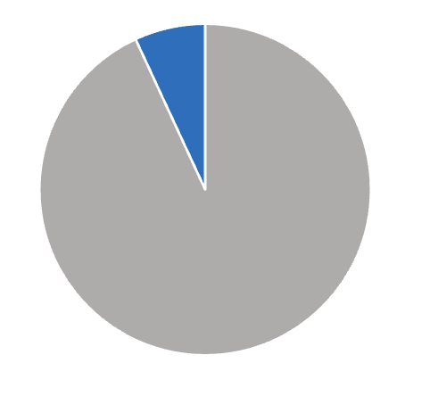
7% Breakdown — Solid Cancers
ICD-O-3, Histologic Type and Behavior | % Microscopic | % Non-Microscopic
8003/3: Malignant tumor, giant cell type | 28.6% | 71.4%
9380/3: Glioma, malignant | 38.1% | 60.5%
9384/3: Subependymal giant cell astrocytoma, malignant | 50.0% | 50.0%
9381/3: Gliomatosis cerebri | 50.0% | 50.0%
8170/3: Hepatocellular carcinoma, NOS | 47.2% | 49.1%
8312/3: Renal cell carcinoma | 58.2% | 39.2%
8000/3: Neoplasm, malignant | 11.9% | 46.7%
8010/3: Carcinoma, NOS | 60.5% | 31.1%
8440/3: Cystadenocarcinoma, NOS | 66.7% | 29.7%
9510/3: Retinoblastoma, NOS | 58.2% | 40.2%
8162/3: Klatskin tumor | 70.6% | 28.8%
9184/3: Osteosarcoma in Paget disease of bone | 83.3% | 16.7%
9161/3: Hemangioblastoma, malignant | 85.7% | 14.3%
9530/3: Meningioma, malignant | 80.5% | 13.7%
9560/3: Neurilemoma, malignant (OBS) | 81.3% | 12.5%
8850/3: Liposarcoma, NOS | 84.1% | 13.5%
9261/3: Adamantinoma of long bones | 88.9% | 11.1%
8121/3: Schneiderian carcinoma | 90.0% | 10.0%
9421/3: Pilocytic astrocytoma, malignant | 89.9% | 10.1%
9391/3: Ependymoma, NOS | 90.4% | 9.2%
8171/3: Hepatocellular carcinoma, fibrolamellar | 89.3% | 10.6%
8046/3: Non-small cell carcinoma | 88.8% | 9.4%
8316/3: Cyst-associated renal cell carcinoma | 92.5% | 7.5%
8001/3: Tumor cells, malignant | 91.1% | 7.4%
9105/3: Trophoblastic tumor, epithelioid | 85.7% | 14.2%
8174/3: Hepatocellular carcinoma, clear cell type | 92.2% | 7.9%
8453/3: Intraductal papillary-mucinous carcinoma, invasive | 88.2% | 10.9%
8160/3: Cholangiocarcinoma | 87.5% | 9.6%
8151/3: Insulinoma, malignant | 88.3% | 11.8%
9050/3: Mesothelioma, malignant | 83.5% | 8.8%
9440/3: Glioblastoma, NOS | 92.8% | 6.0%
8700/3: Pheochromocytoma, malignant | 91.2% | 5.3%
9100/3: Choriocarcinoma, NOS | 89.4% | 10.0%
9064/3: Germinoma | 92.6% | 6.7%
9130/3: Hemangioendothelioma, malignant | 86.3% | 4.5%
8800/3: Sarcoma, NOS | 89.7% | 5.5%
9140/3: Kaposi sarcoma | 92.1% | 5.5%
8002/3: Malignant tumor, small cell type | 50.0% | 0.0%
8095/3: Metatypical carcinoma | 50.0% | 0.0%
8894/3: Angiomyosarcoma | 66.7% | 0.0%
9170/3: Lymphangiosarcoma | 66.7% | 33.3%
9512/3: Retinoblastoma, undifferentiated | 66.7% | 33.3%
9104/3: Malignant placental site trophoblastic tumor | 75.0% | 25.0%
9251/3: Malignant giant cell tumor of soft parts | 75.0% | 25.0%
9511/3: Retinoblastoma, differentiated | 80.0% | 20.0%
8014/3: Large cell carcinoma with rhabdoid phenotype | 83.4% | 0.0%
8272/3: Pituitary carcinoma, NOS | 85.7% | 0.0%
8711/3: Glomus tumor, malignant | 87.5% | 6.3%
8741/3: Malignant melanoma in precancerous melanosis | 90.0% | 0.0%
8450/3: Papillary cystadenocarcinoma, NOS | 91.7% | 8.3%
9062/3: Seminoma, anaplastic | 92.9% | 0.0%
20% 40% 60% 80% 100%
Non-microscopic: 6.9%
51 Solid Cancers
20 Heme Cancers
Microscopic
93.1%
Notes:
Solid: 8000/3 – 9589/3
Heme: 9590/3 +

Slide 7
7% Breakdown — Heme Cancers
ICD-O-3, Histologic Type and Behavior | % Microscopic | % Non-microscopic
9965/3: Myeloid and lymphoid neoplasms w/PDGFRA rearrangement | 85.7% | 14.3%
9800/3: Leukemia, NOS | 37.5% | 19.5%
9946/3: Juvenile myelomonocytic leukemia | 85.7% | 14.3%
9964/3: Chronic eosinophilic leukemia, NOS | 66.7% | 31.8%
9590/3: Malignant lymphoma, NOS | 55.6% | 23.3%
9823/3: Chronic lymphocytic leukemia/small lymphocytic lymphoma | 90.7% | 6.75%
9761/3: Waldenstrom macroglobulinemia | 87.4% | 9.01%
9801/3: Acute undifferentiated leukemia | 68.1% | 17.7%
9872/3: Acute myeloid leukemia with minimal differentiation | 88.5% | 5.74%
9860/3: Myeloid leukemia, NOS | 80.4% | 2.31%
9732/3: Plasma cell myeloma | 89.2% | 7.15%
9876/3: Atypical chronic myeloid leukemia, BCR-ABL1 negative | 91.8% | 8.16%
9820/3: Lymphoid leukemia, NOS | 74.1% | 7.41%
9832/3: Prolymphocytic leukemia, NOS | 78.3% | 17.4%
9945/3: Chronic myelomonocytic leukemia | 92.2% | 6.16%
9931/3: Acute panmyelosis with myelofibrosis | 88.6% | 11.4%
9827/3: Adult T-cell leukemia/lymphoma | 93.1% | 0.00%
9591/3: Non-Hodgkin lymphoma, NOS | 92.7% | 2.78%
9863/3: Chronic myeloid leukemia, NOS | 86.4% | 7.22%
9963/3: Chronic neutrophilic leukemia | 93.3% | 6.67%
20% 40% 60% 80% 100%

Slide 8
Summary
Primary endpoint concordance across databases:
NPCR and SEER
NAACCR next
Overall, 93% of cancers are microscopically confirmed
Breakdown of heme and solid cases < 94%

