Slide 1
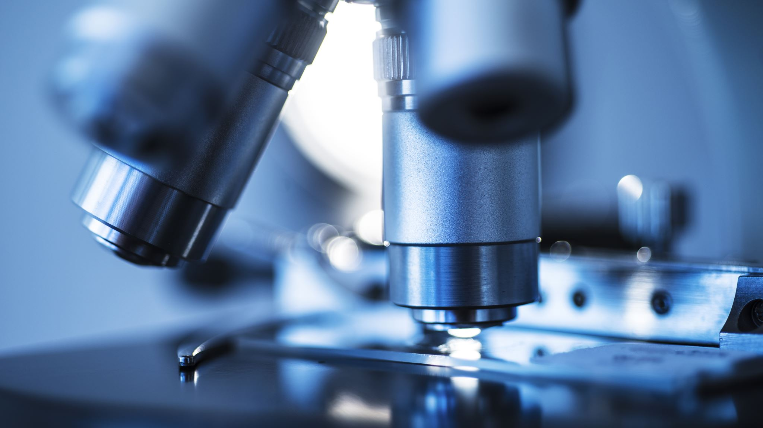
“SEER Microscope”
Investigating Trends in the Use of Light Microscopy for the Diagnosis of Cancer

Slide 2
Project

Slide 3
Pathology Innovation Collaborative Community
The Alliance for Digital Pathology and AI/ML
You value
Collaborations
You have a
Regulatory
Science Project
You propose
your project
to PIcc
You present
to steering
committee
PIcc helps
organize the
project
PIcc is a network
to find interested
collaborators
Focus is NOT on
competitive
product development
PIcc does NOT
actively participate
in your project
PIcc is a collaborative community that provides
the infrastructure to connect stakeholders
Notes:
You have a regulatory science project, an idea, or a topic relevant to the field. You value collaborations with other stakeholders You contact PIcc and propose a project (either by e-mail or with the form) We present it by the steering committee We help organize the project (either an existing workgroup or as a separate project)
Participation is free and non-binding
We help present the scope and vision on the website - so you can e-mail this to your collaborators There are some rules regarding scope (i.e., non-competitive space; code of conduct)
Otherwise it is an all-inclusive collection of stakeholders that want to move the field forward.If you have question - contact us at PIcc.....
PIcc = a network you can tap into to find interested individuals to support and participate in your project
PIcc ≠ active participation in your project

Slide 4
Investigating Trends in the Use of Light Microscopy for the Diagnosis of Cancer Addressed Parties:
We are looking for collaborators, supporters, and stakeholders interested in analyzing how the diagnosis of cancer has shifted with recent technological advancements.
We are specifically interested in the real-world data on how cancer is diagnosed in the US today.

Slide 5
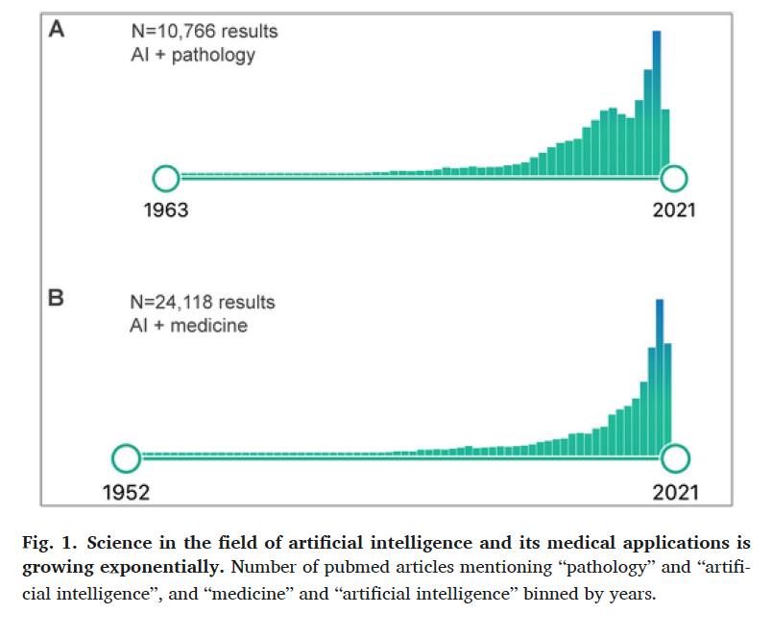
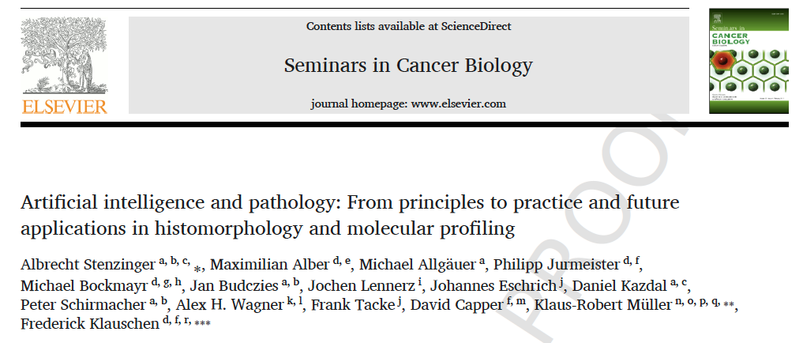
Background: AI
In recent years, novel methods of cancer diagnosis have been introduced including cell-free DNA, whole slide imaging, and artificial intelligence (AI) applications.

Slide 6
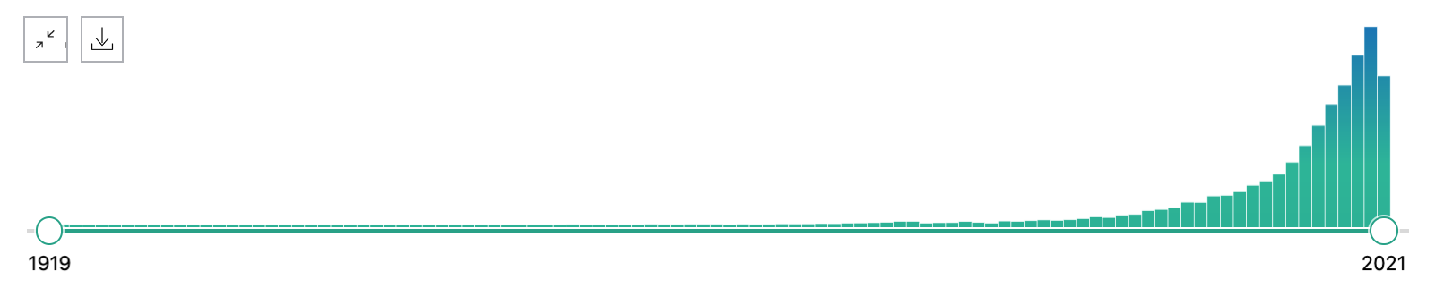
Background: cfDNA
The use of cell-free DNA for noninvasive diagnostic purposes has proven to be a feasible future tool, though current knowledge of how tumors release cell-free DNA is limited
16,774 results
79% [13,392/16,774] in last 10 years
Barbany G, Arthur C, Liedén A, et al. Cell-free tumour DNA testing for early detection of cancer - a potential future tool. J Intern Med. 2019;286(2):118-136. doi:10.1111/joim.12897

Slide 7
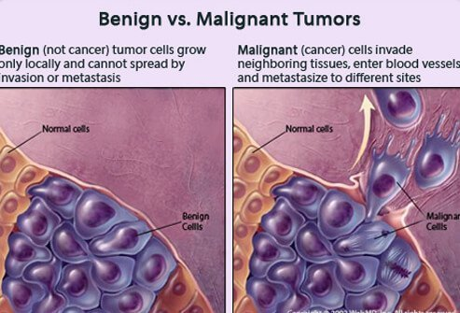
Cancer, Malignancy
NCI Definition:
Malignant cells can invade and destroy nearby tissue and spread to other parts of the body.
Throughout the evolution of cancer diagnostics, it has been well understood that light microscopy represents the most used approach.
Light microscopy represents a gold standard or baseline of cancer diagnosis to which novel instruments will be compared for valuation

Slide 8
Key question(s)
The quantification of physicians’ use of light microscopy amid these technological advancements has not yet been well defined.
Understanding the magnitude of light microscopy’s use in the current diagnostic climate is relevant amid a surge in innovation.

Slide 9
SEER database

Slide 10
SEER Database Geography

Slide 11
SEER data flow
Remove duplicates, consolidate
Patient X-ray. Pathology diagnosis Local registry State registry. SEER

Slide 12
Idea…
During routine clinical slide scanning at CID
Question came up
Discussed with several people
Nisha Ramamurthy, UNC Gillings School of Global Public Health
Summer Internship 2021

Slide 13
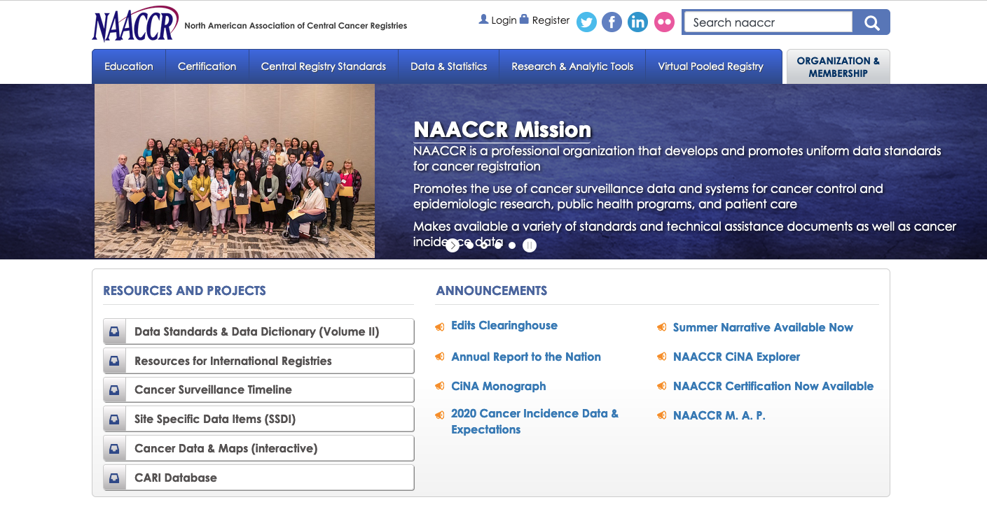
Approach
SEER follows NAACCR terminology
Contact?

Slide 14
NAACCR Item #490
“Code for the best method of diagnostic confirmation of the cancer being reported at any time in the patient’s history.”
Distinguishes
Heme vs. non-heme

Slide 15
Cancer types
ICD-O-3 codes (distinguish heme vs. non-heme)
Encodes for histologic type and behavior
Established and used in WHO Blue book (“de-facto” gold standard)
Grouping of tumors? AYA (adults and young adults); WHO grouping by site;
SEER site list: https://training.seer.cancer.gov/disease/categories/site.html
Suggestion: Site recode parent tree =>

Slide 16
Proposal & Relevance
We propose to use the SEER Cancer Registry to arrive at a national percentage of cancer diagnoses (across tumor/cancer-types; ICD-0) rendered through the light microscope.
This analysis can provide payers and health technology assessments (HTAs) with a better assessment of current diagnostic climate, and aid in preparation for efficient and accessible cancer diagnostics solutions.

Slide 17
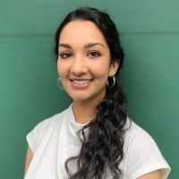
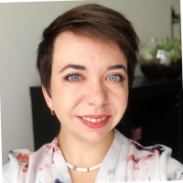
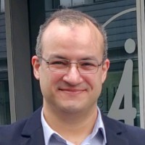
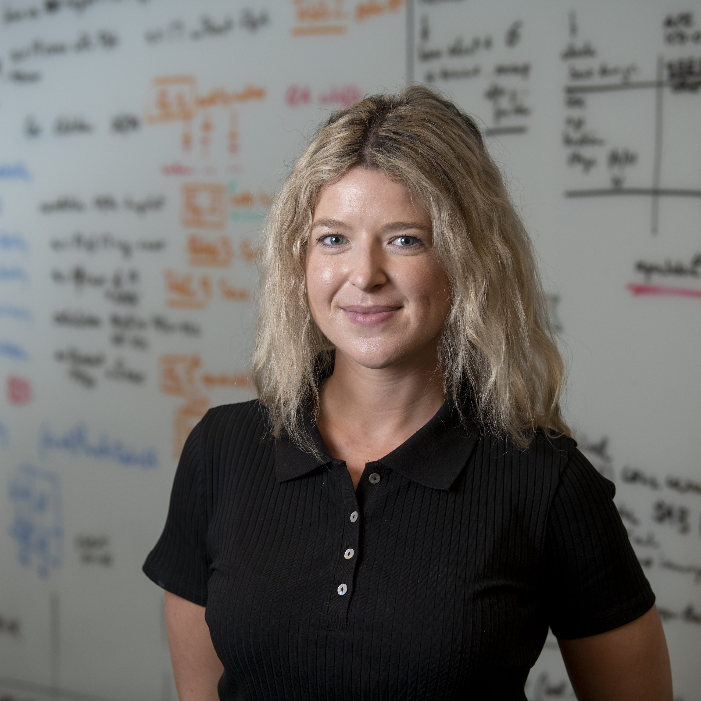
Team – do you want to join?
Nisha Ramamurthy
UNC Chapel Hill
Potomac, MD
Alex Farahani
CID, MGH
Boston, MA
Emma Gardecki
Smith College
Northampton, MA
Kate Elfer
Interagency Oncology
Task Force, NCI-FDA
Joe Lennerz
CID, MGH/HMS
Boston, MA
Kyungmin Ko
Texas Childrens Hospital
Houston, TX
Ahmad Samir Alfaar
Ulm/Berlin
Germany
Uta Schmidt-Strassburger
Ulm University
Germany
Gina Giannini
Regulatory Affairs
Roche
Jared Woods
DFCI/BWH
Boston, MA
Ula Green
CID, MGH
Boston, MA

Slide 18
Next steps & Meetings
ONE. Design
Introduction (check)
Discussion
TWO. Data + Review
Review.
Discussion
THREE. Draft review and editing
Review of draft “storyline”
Circulation among authors

Slide 19
Discussion
Scope - To what degree do “we” depend on light microscopy for cancer diagnosis?
Primary endpoint: % of cancer diagnoses rendered by light microscopy for national extrapolation
Secondary endpoints: 1) accuracy comparison (pathology vs. other e.g. treatment; see next slide) exploring trends over time – specific to cancer type. 2) geographic trends 3) survival by “diagnostic modality” (interesting idea; see next slide) 4) edge cases (review) 5)
Updating NAACCR #790 ?
Relevance

Slide 20
Discussion
Ahmad
SEER: NAACCR - availability 1995+ until 2018; 23 years
Survival: requires review/application by a member
SEER-V9: 1975-2018; includes survival and incidence (n=9 registries; 10% of US by population and 99% representative of US)
Markers: biomarkers – typically available >2004 or even 2008; heterogeneity across registries
Treatment fields: accuracy [e.g., from most to least accurate by PPV: radiation > surgery > chemo > hormonal/other <60%]; across versions
Payment data: additional data, management, => pathology data is considered reliable (likely focused on individual cancers)
Privacy concern when number is <16 patients => strong argument for higher level groupings.
Jared:
updating NAACCR => esp. heme/neuro (where molecular findings may be key)
Kate
Impact of new technology on cancer prevention; new clinical and research
Specific impact of light technologies; impact of new relies of baseline
Gina
Risk assessment – as related to incidence/prevalence; risk mitigation

Slide 21
“SEER Microscope”
Investigating Trends in the Use of Light Microscopy for the Diagnosis of Cancer

